Slide 1

PRESENTATION OF
APPLIED PHYSICS

Slide 2

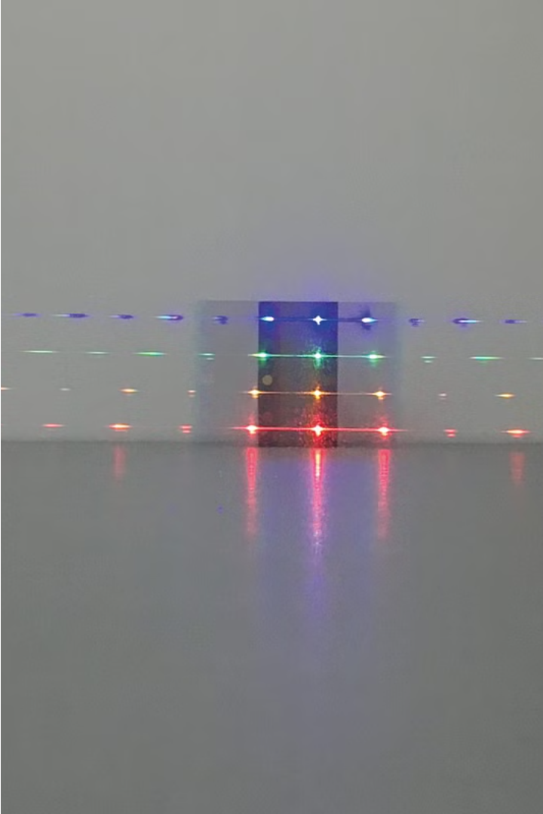

Interference of Light
In this presentation, we'll explore the fascinating phenomenon of light interference.
Presented by the Group Members

Slide 3
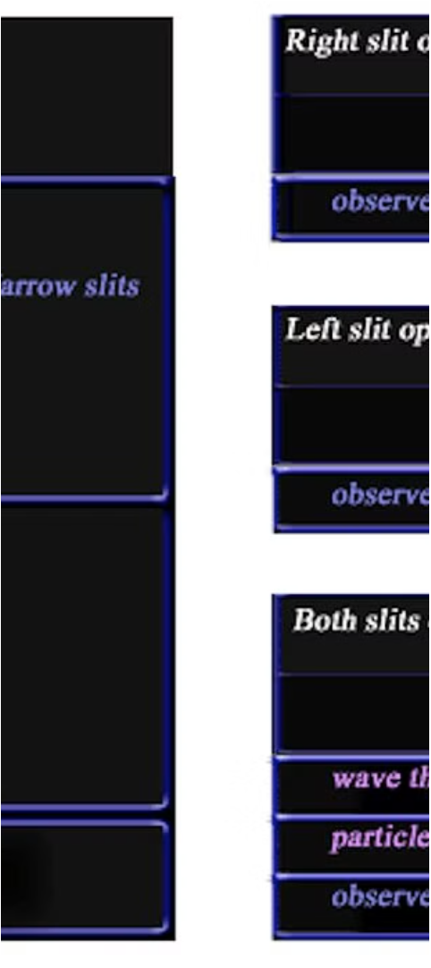
Discovery of Light Interference
1
Young's Double Slit Experiment
In 1801, Thomas Young conducted a seminal experiment that demonstrated the wave nature of light and the phenomenon of interference.
2
Constructive and Destructive Interference
Young's experiment revealed how light waves can interfere with each other, resulting in regions of increased (constructive) and decreased (destructive) intensity.
3
Wave-Particle Duality of Light
The discovery of interference challenged the prevailing particle view of light, leading to the understanding of the wave-particle duality of light.

Slide 4
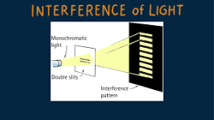
DEFINITION
Light interference occurs when two or more light wave intracts,resulating in the strengthening (constructive interference) or weakening (destructive interference) of the combined waves.
This happens because light exhibits both particle and wave like properties, allowing for these complex interactions.

Slide 5
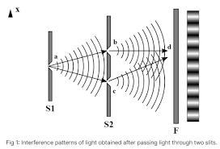
Interference of Light Example’s:
  Double Slit Interference
Thin Film Interference
When light passes through two narrow slits, it creates an interference pattern of bright and dark regions on a screen.
The reflection and refraction of light in a thin film, such as soap bubbles or oil on water, can also result in interference patterns.
Diffraction Grating
A diffraction grating, with its closely spaced parallel slits, can split light into its constituent wavelengths, creating a spectrum.

Slide 6
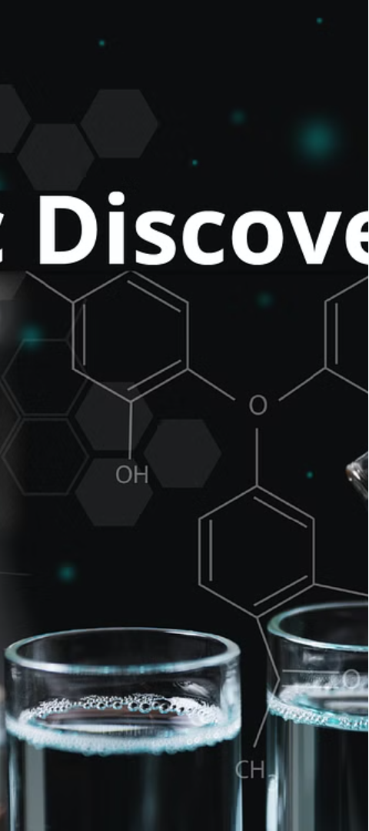
Purpose of Discovering Light Interference
1
Understand the Wave Nature of Light
2
Develop Optical Technologies
Interference phenomena are the basis for many important optical technologies, such as lasers, fiber optics, and holography.
The discovery of interference helped establish the wave-like behavior of light, challenging the prevailing particle view.

Slide 7
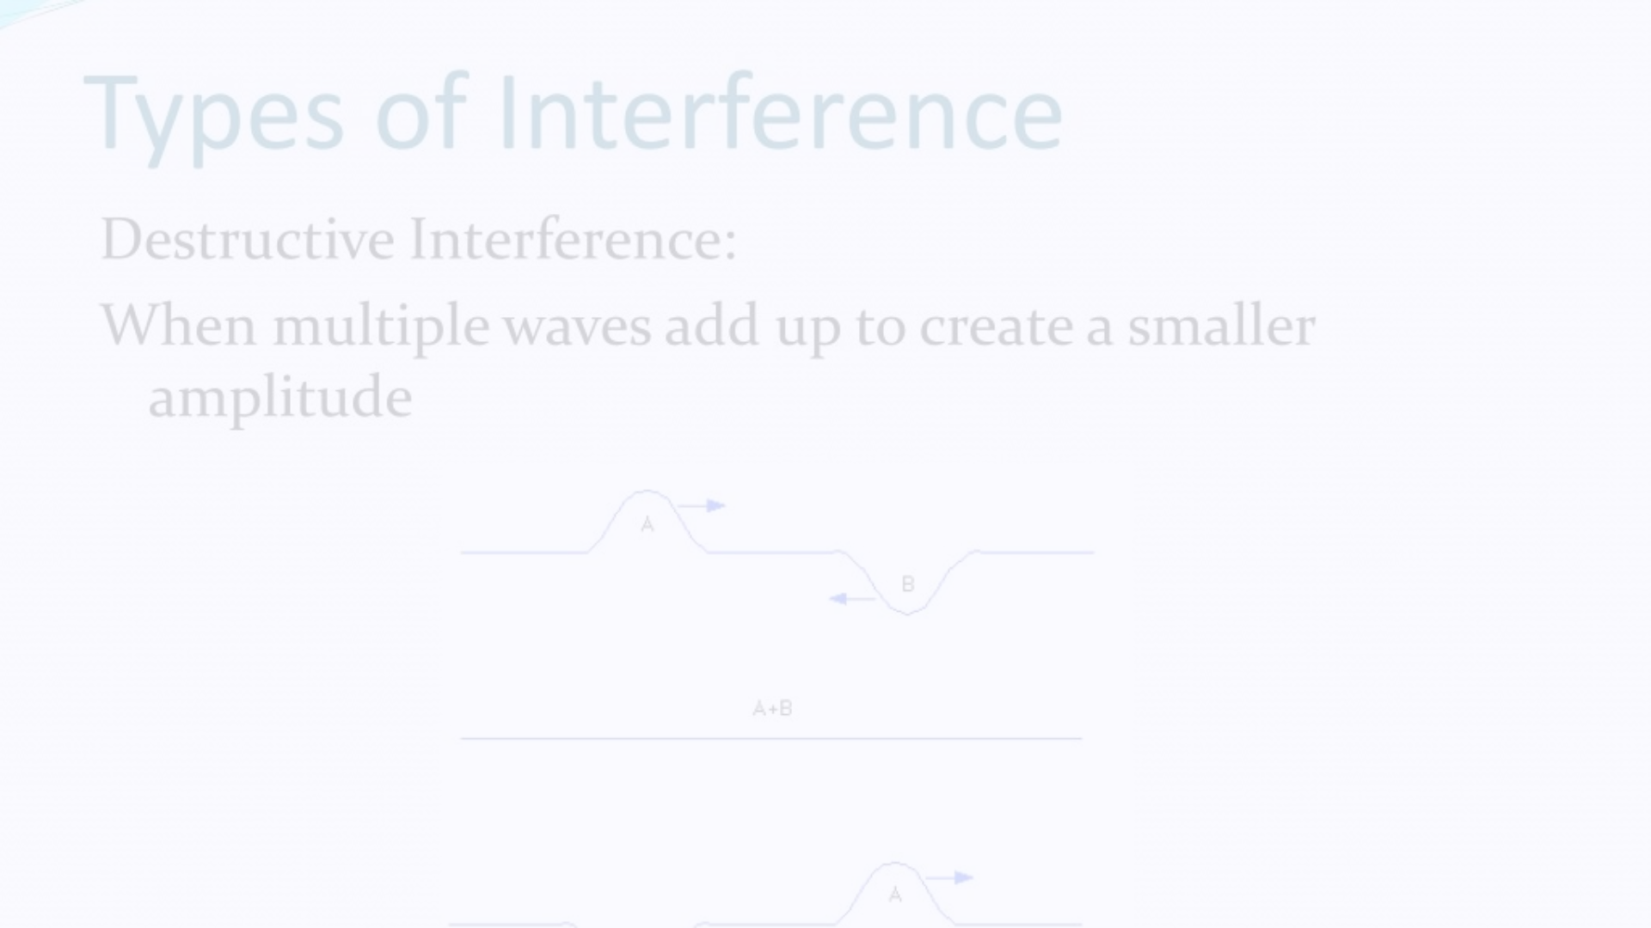
Types of Interference
Young's Double Slit
Thin Film Interference
Diffraction Grating
When light passes through two narrow slits, the resulting interference pattern is a series of bright and dark fringes.
Reflection and refraction of light in a thin film, such as soap bubbles or oil on water, can create colorful interference patterns.
A diffraction grating, with its closely spaced parallel slits, can split light into its constituent wavelengths, creating a spectrum.

Slide 8


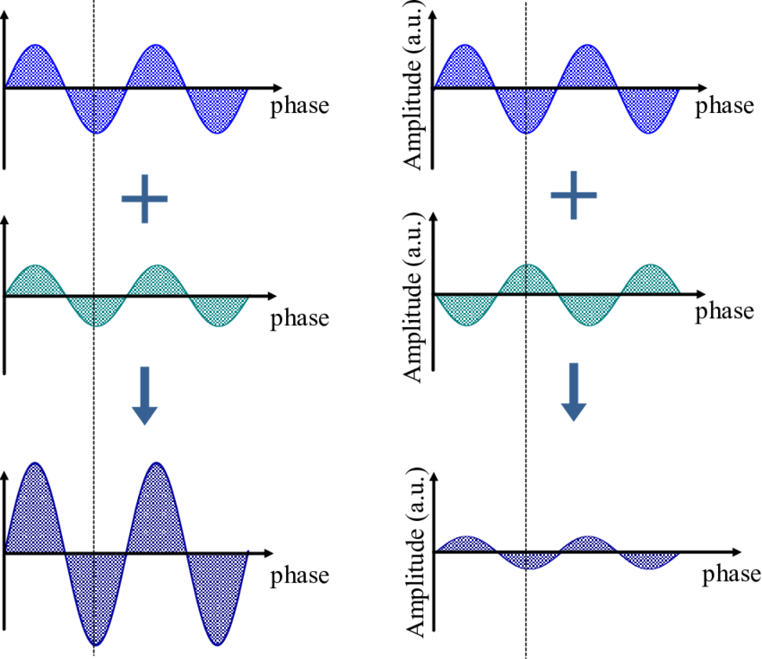
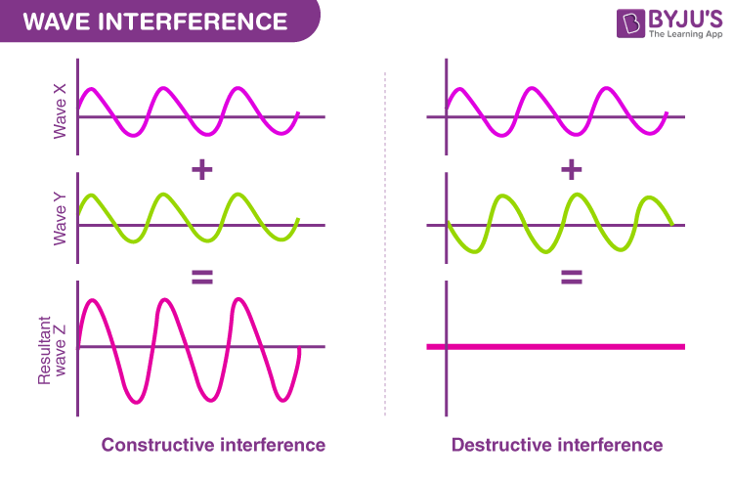
Constructive and Destructive Interference
Constructive Interference
Destructive Interference
When the crests and troughs of two waves align, they add up, resulting in a stronger wave.
When the crest of one wave aligns with the trough of another, they cancel each other out, resulting in a weaker wave.

Slide 9
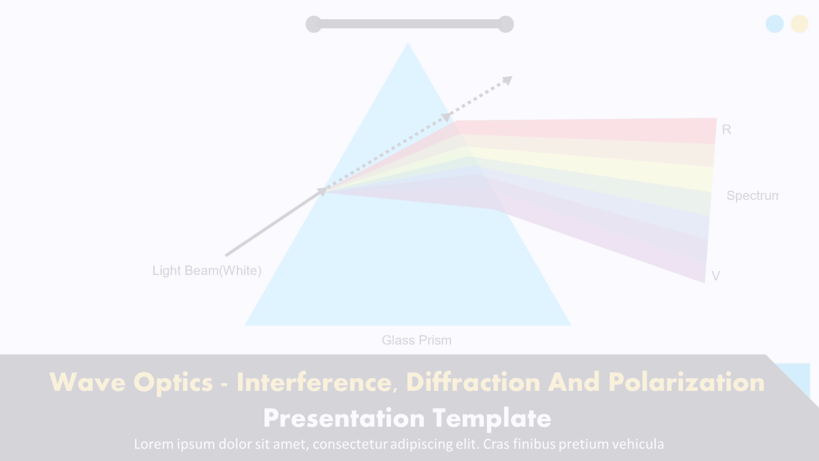



Uses of Light Interference
Optical Filters
Laser Technology
Holography
Interference can be used to create optical filters that selectively transmit or reflect specific wavelengths of light.
Interference is the underlying principle behind the operation of lasers, which are essential for many applications.
Interference of coherent light is the basis for creating holographic images, which have a 3D-like appearance.

Slide 10

Conclusion
The uses of interference of light span diverse fields, enhancing technology, improving scientific understanding, and contributing to everyday conveniences. Its applications in precision measurement, medical imaging, telecommunications, material science.

Slide 11
Hope all of you have Understand the Topic

