Slide 1


Slide 2


Slide 3


Presented by:
MUNEEB IRFAN
UMAR ASLAM
M.HASSNAIN
JAAM AMIR
SAIM HASSAN

Slide 4


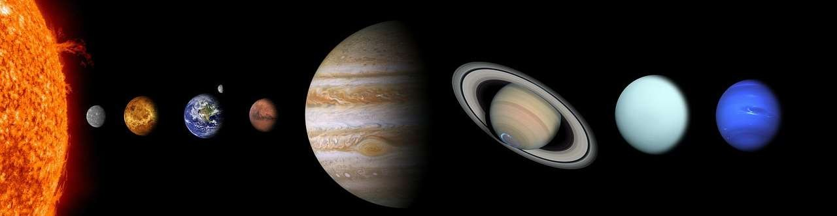
EXPANTION OF THE UNIVERSE

Slide 5
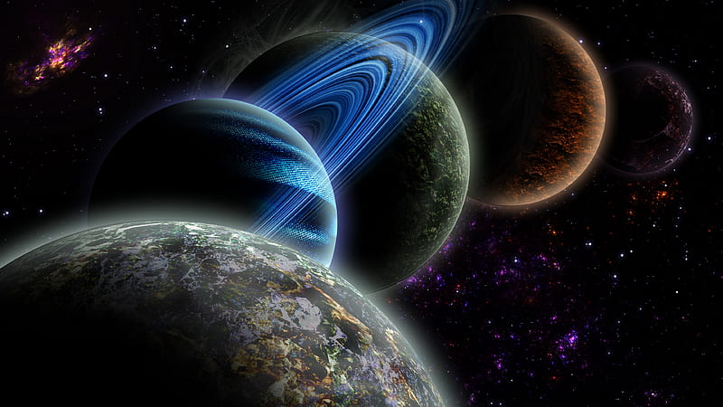
Introduction of the Universe
The universe is very vast.
it contains all matter, energy, planets, stars, galaxies, and even the fabric of spacetime itself.
It is the totality of all space, time, matter, and energy. Understanding the universe and its origins is a fundamental question that has intrigued humanity for centuries, and various scientific disciplines, including astronomy, physics, and cosmology, seek to unravel its mysteries.
.

Slide 6
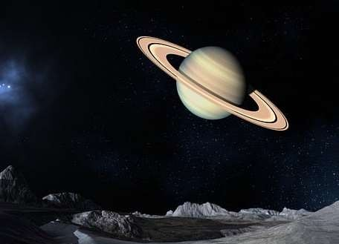
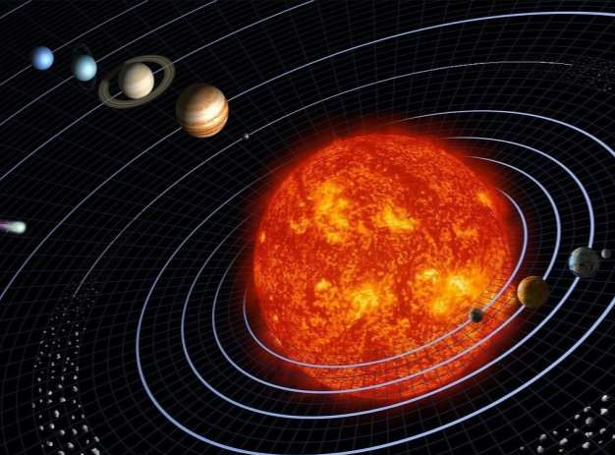
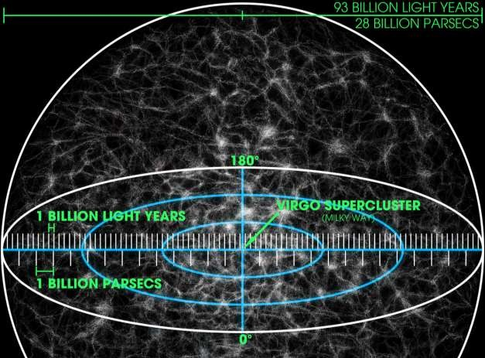
1. Scale and Size:
The universe is unimaginably vast, with an estimated observable diameter of about 93 billion lightyears. However, the entire universe may be much larger than what we can currently observe.
It consists of countless galaxies, each containing billions to trillions of stars, as well as other celestial objects like planets, moons, asteroids, and comets.

Slide 7

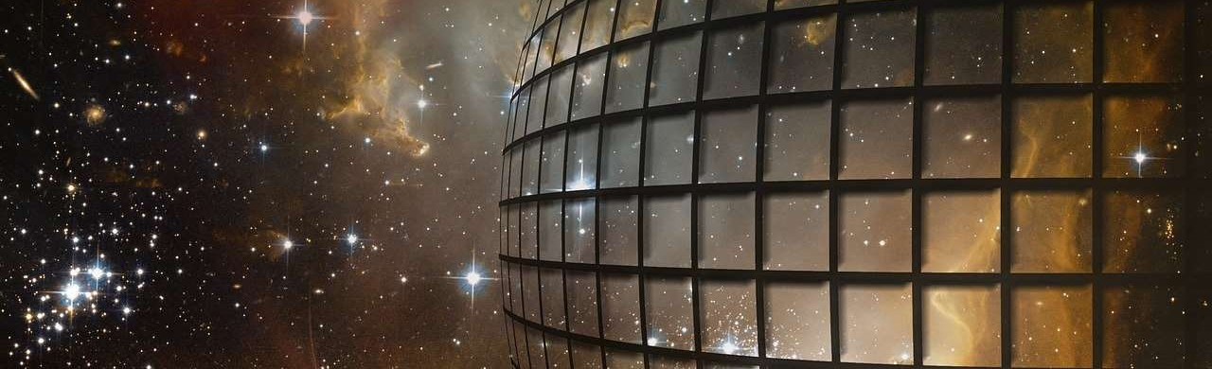
2. Composition:
The basic building blocks of the universe are elementary particles, such as quarks and leptons, which combine to form atoms. Hydrogen and helium are the most abundant elements in the universe, with heavier elements produced in stars through nuclear fusion.

Slide 8

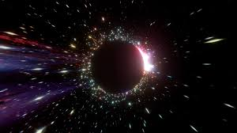
3. Structure:
The largescale structure of the universe is characterized by the arrangement of galaxies in vast structures known as filaments, sheets, and voids. These structures are shaped by the gravitational pull of dark matter, a mysterious and invisible substance that makes up a significant portion of the universe's mass.

Slide 9
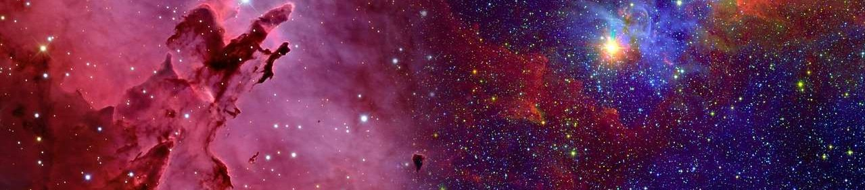
4. Cosmic Microwave Background (CMB):
The cosmic microwave
background radiation is
a faint glow that permeates
the entire universe. It
is the residual heat left
over from the Big Bang
; the event believed to
have marked the
beginning of the universe
around 13.8 billion years
ago.

Slide 10

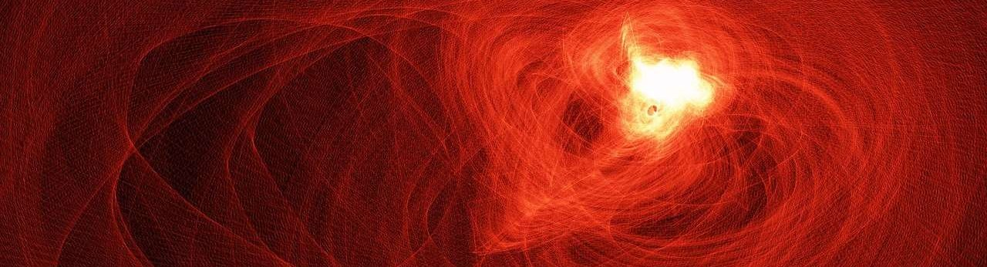
5. Expansion:
The universe is expanding, as evidenced by the observation that galaxies are moving away from each other. This discovery, made in the early 20th century, led to the formulation of the Big Bang theory, which posits that the universe began as an extremely hot and dense state and has been expanding ever since.

Slide 11

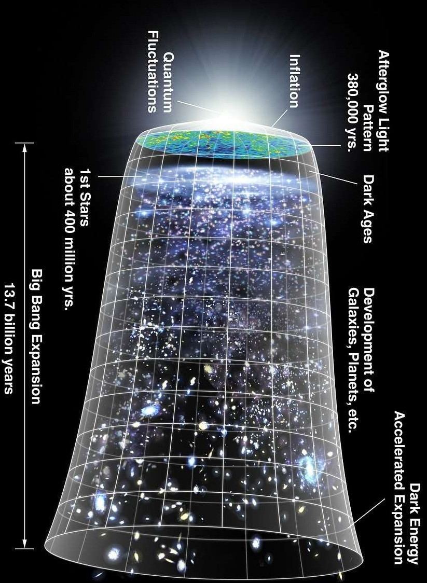
5. EXPANSION:

Slide 12

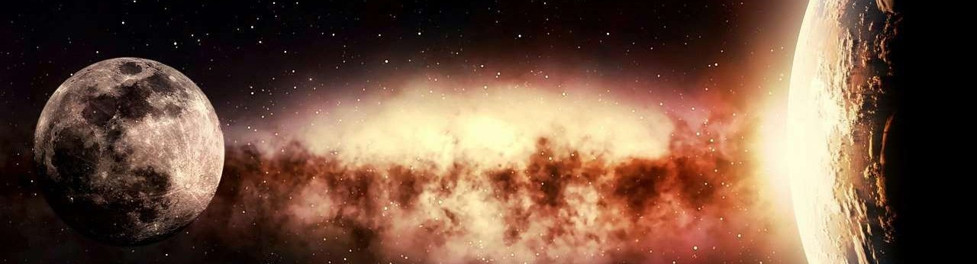
6. Dark Energy:
The universe is expanding, as evidenced by the observation that galaxies are moving away from each other. This discovery, made in the early 20th century, led to the formulation of the Big Bang theory, which posits that the universe began as an extremely hot and dense state and has been expanding ever since.

Slide 13

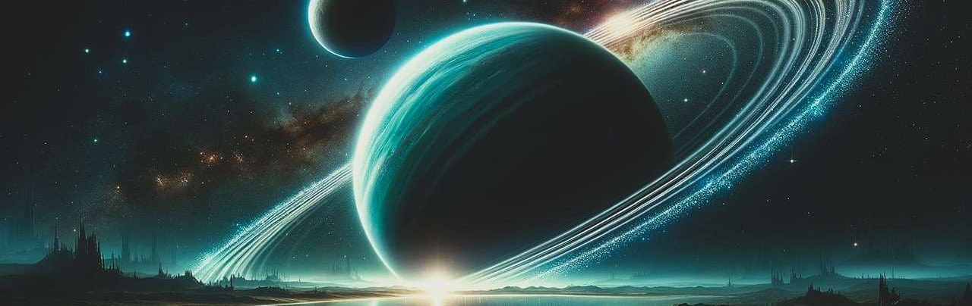
7. Dark Matter:
Dark matter, comprising about 27% of the universe's energy density, is another enigmatic component. It does not emit, absorb, or reflect light, making it invisible and detectable only through its gravitational effects on visible matter.

Slide 14

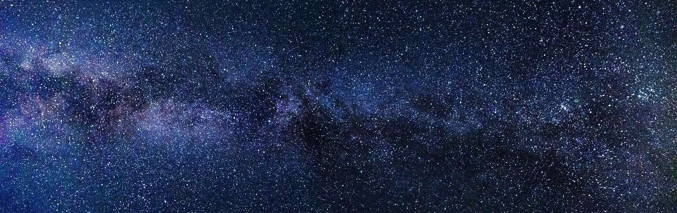
8. Galaxies:
Galaxies are massive systems containing stars, stellar remnants, interstellar gas, dust, and dark matter, all bound together by gravity. The Milky Way, our galaxy, is just one of billions in the observable universe.

Slide 15

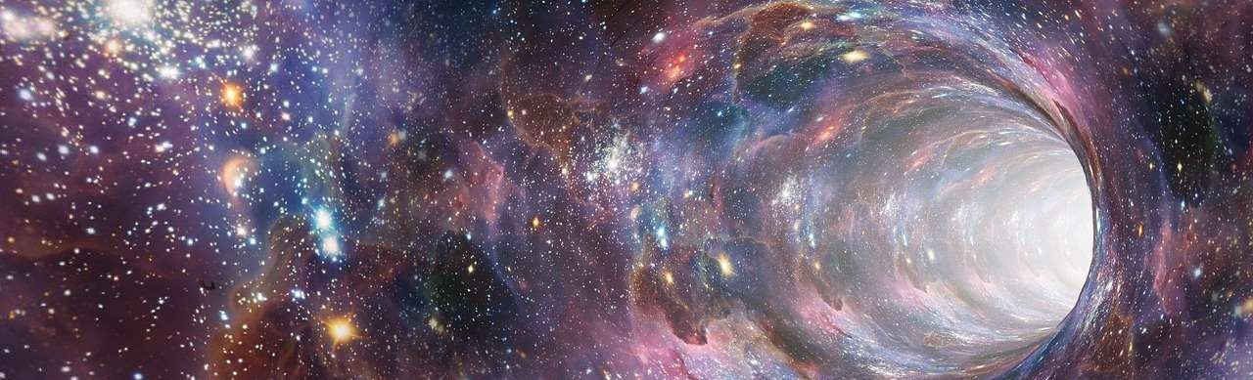
9. Black Holes:
Black holes are regions of spacetime where gravity is so intense that nothing, not even light, can escape. They form when massive stars collapse under their own gravitational pull.

Slide 16

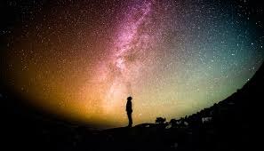
How old is the universe?
The age of the universe is estimated to be approximately 13.8 billion years. This age is based on observations of the cosmic microwave background radiation, the afterglow of the Big Bang, as well as other cosmological data. The estimate has been refined over the years through observations from telescopes such as the Hubble Space Telescope and measurements of the largescale structure of the universe.

Slide 17

That’s all from our side

Slide 18


